Slide 1

DNA
Deep Network Analysis
Data drives the message
Team A9:
Anish Malhotra
Mehmed Mladenov
Marc Tse

Slide 2

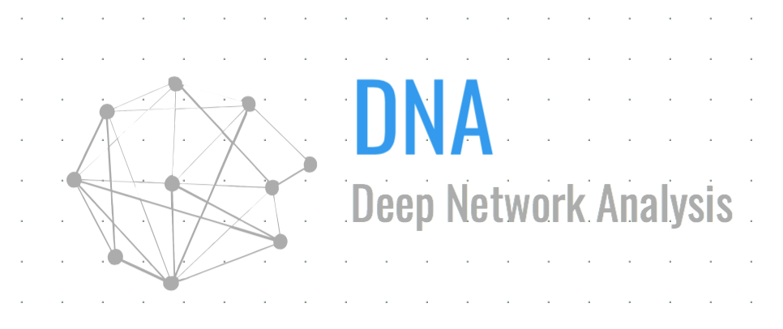
Status Quo
High skill-based jobs
Data Misuse/Privacy Breach
Data Security

Slide 3
Observations
Companies employ large teams of expertise spanning multiple fields in order to conduct data analysis.
Concerns from general public on individual data collected.
Concerns about individual employees leaking data.

Slide 4
Story
Lack of expertise in this field → cannot easily find large pools of experts, therefore need to incur large expenditures on hiring skilled personnel.
Because of specific skill set required for data analytics, most growing companies are not able to incorporate these methods to determine insights and strategy for growing their operations.
General public is distrusting of organizations using data analytics when potential for growth is immense.

Slide 5
Insight - Requirements
Estimates for global spending on big data in 2018 exceed $114 billion USD.¹
80% of enterprises and 63% of small & medium businesses (SMBs) already have deployed or are planning to deploy big data projects in next 12 months.²
Just 51% of data analytics decision makers said they could easily obtain data and analyze it without technologist → estimated to rise to 66% in 2017.³

Slide 6
Insight - Requirements
When asked about next big marketing trend, survey respondents identified consumer personalization (29%), AI (26%), and voice search (21.23%).⁴
Top 3 responses, totalling 75% of all AI applications, demonstrate AI is more pervasive and prominent than respondents realize.⁴
Impact of AI technologies on business projected to increase labor productivity up to 40% and enable more efficient use of time. ⁵

Slide 7
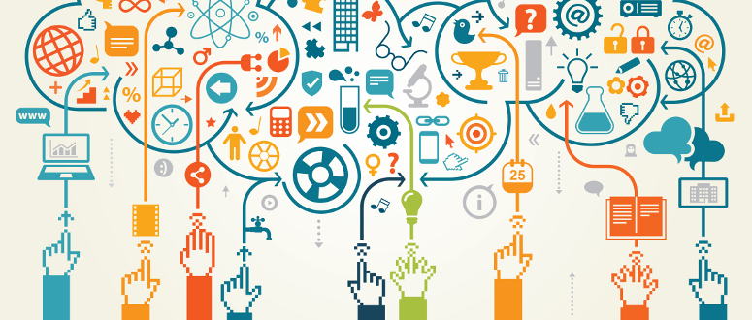
Opportunity - Analysis
Data analytic operations can be democratized
Large interest → provide more incentives

Slide 8
Opportunity - Analysis
With help of machine learning, companies no longer have to invest money into technologists for decision making → productivity can increase substantially
Marketing strategy trending towards consumer personalization

Slide 9
Analogy
GoDaddy commercial transition 2013 → 2015. From a kiss to a lost dog, tattoo artist.
GoDaddy’s CEO: “It’s telling of the way that market is changing” - machine learning and data analytics can predict the trends of the market⁶

Slide 10
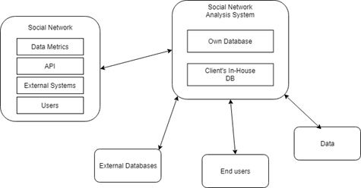
Solution - Design
Context Diagram

Slide 11
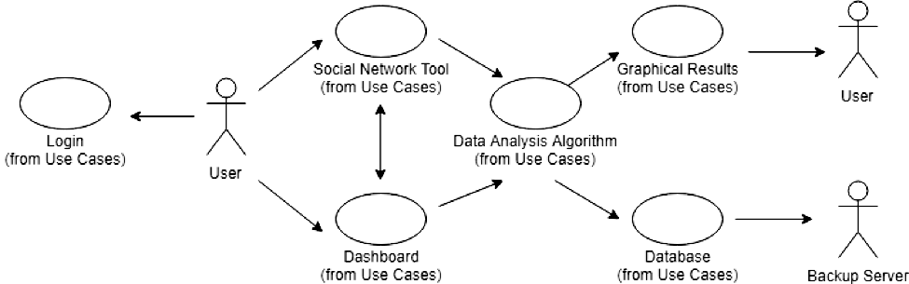
Solution - Design
Use Case Diagram

Slide 12
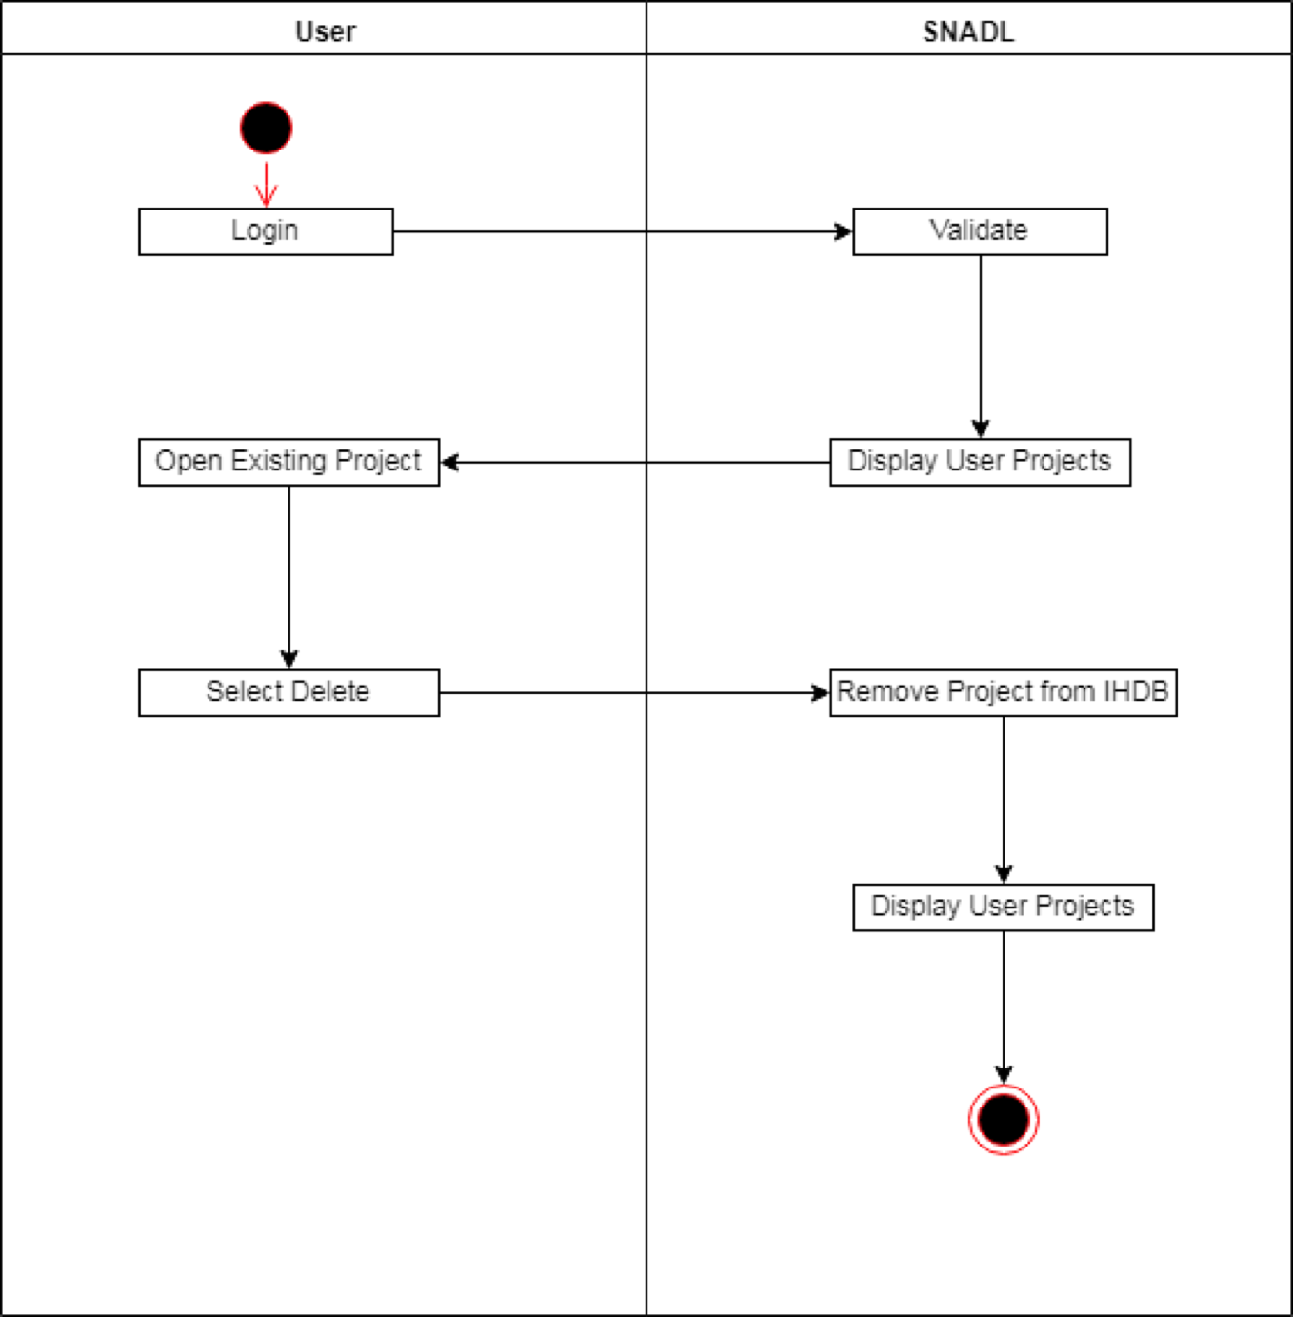
Solution - Design
Event:
Display User Projects
Create/Open/Delete

Slide 13
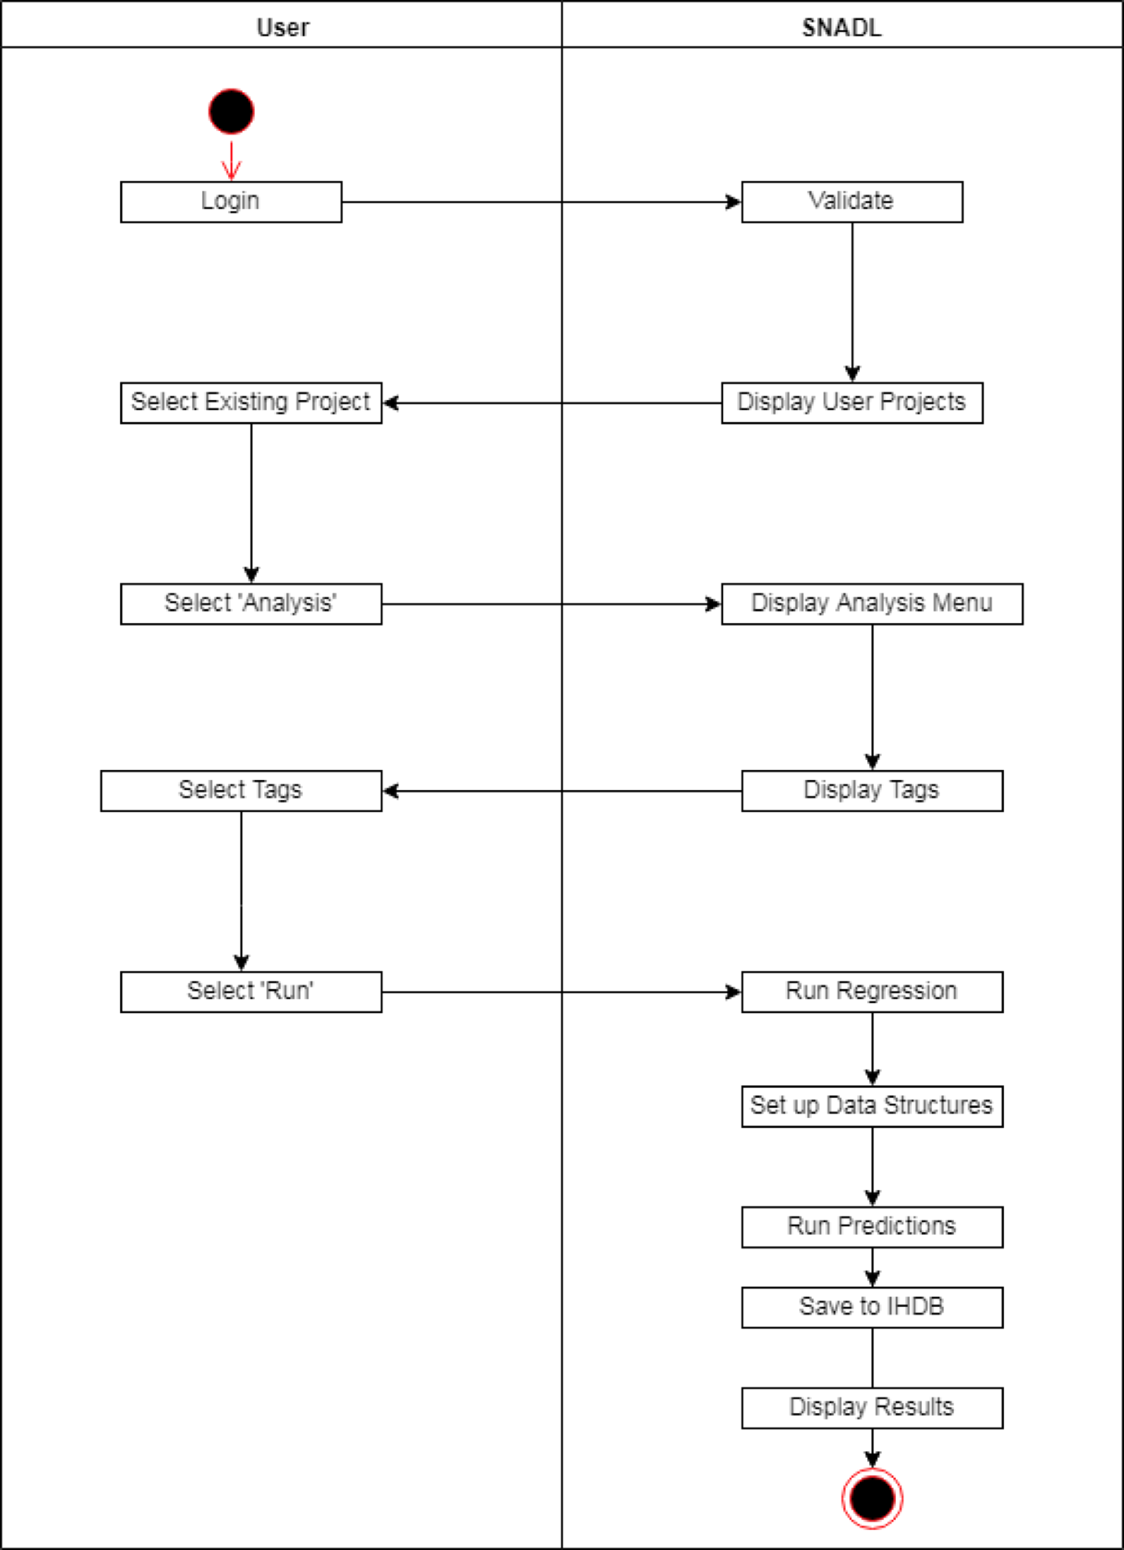
Solution - Design
Event:
Data Analysis
Pre-built set of tags

Slide 14
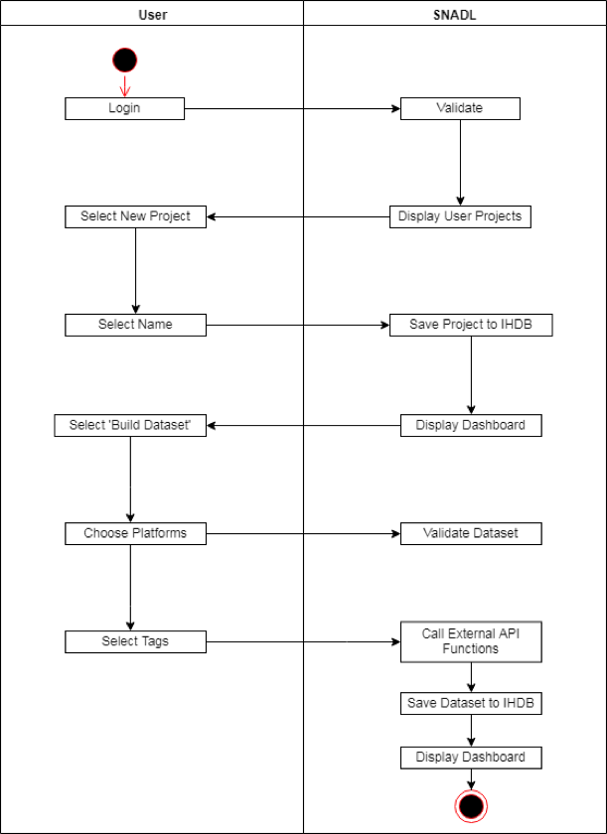
Solution - Design
Event:
Tag Manager
External APIs

Slide 15
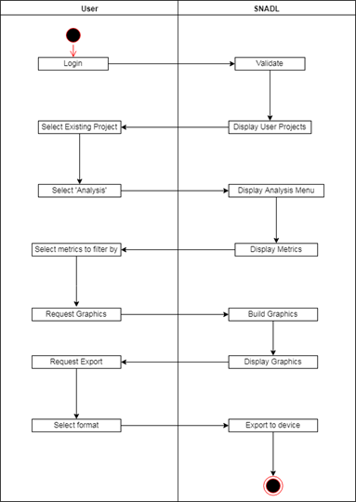
Solution - Design
Event:
Display Graphical Result
Formatting
Export

Slide 16
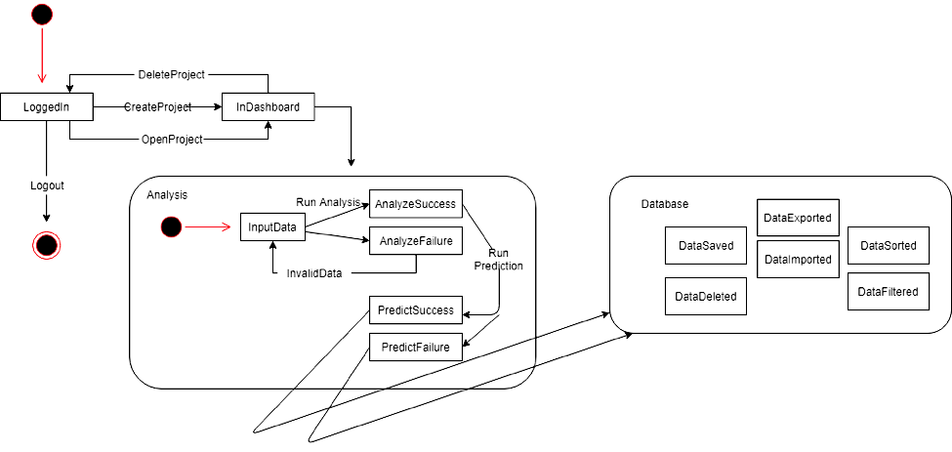
Solution - Design

Slide 17
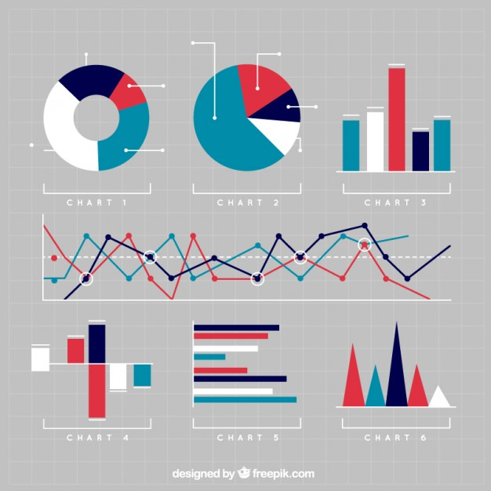
Advantage
No advanced knowledge required
Customizable analysis
Exportable to different formats
Scalability

Slide 18
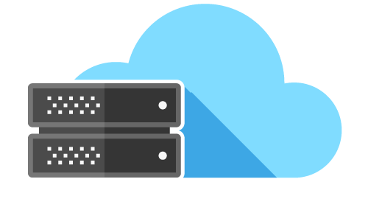
Ethos - Future work
Current iteration only supports analysis on social networks
More platforms, markets and data types
Serverless Architecture

Slide 19
Post Implementation Review
Common Defects:
Formatting Errors
Incorrect Diagrams

Slide 20
Post Implementation Review
Things We Could Have Done Better:
Better research
Better communication
Meeting more regularly

Slide 21
Post Implementation Review
Things We Did Well:
Reduced number of defects per document
Solid definition of project
Good division of workload

Slide 22
Initial RAS Defect Chart
Artifact or Deliverable | Who (Individual or Team) | Estimated | Actual | Difference
RAS Business & Project Definition | Anish | 7 | 12 | 5
 | Mark | 8 | 12 | 4
 | Mehmed | 6 | 12 | 6
 | Summary (Avg.) | 7 | 12 | 4

Slide 23
SPMP Defect Chart
Artifact or Deliverable | Who (Individual or Team) | Estimated | Actual | Difference
SPMP | Anish | 11 | 2 | 9
 | Mark | 5 | 2 | 3
 | Mehmed | 9 | 2 | 7
 | Summary (Avg.) | 8 | 2 | 6

Slide 24
Questions and Answers

Slide 25
Works Cited
¹:https://www.abiresearch.com/press/big-data-spending-to-reach-114-billion-in-2018-loo/
²:https://www.forbes.com/sites/louiscolumbus/2015/03/15/data-analytics-dominates-enterprises-spending-plans-for-2015/#716c2e3b1801
³:https://channels.theinnovationenterprise.com/articles/data-analytics-top-trends-in-2017
⁴:http://www.cmo.com/features/articles/2017/8/24/15-mindblowing-stats-about-artificial-intelligence-dmexco.html#gs.C8AMRi8
⁵:https://www.accenture.com/sk-en/insight-artificial-intelligence-future-growth
^{6.}:http://adage.com/article/advertising/godaddy-bows-global-campaign/303482

